Slide 1

Fluid Management in ICU
Dr rati Prabha
Associate professor
kgmu

Slide 2
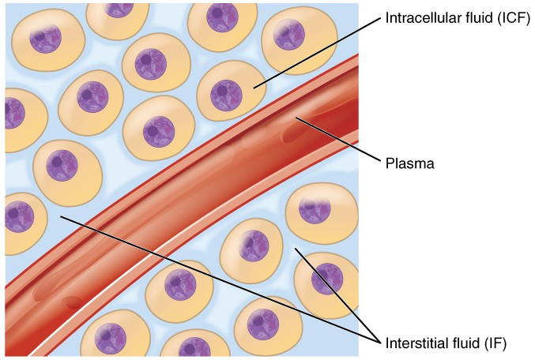
Body fluid compartments
40% of total body fluid
60% of total body fluid

Slide 3
Types of fluid
Crystalloid
Colloids
Blood and blood components

Slide 4
Crystalloids
Crystalloid fluid is an aqueous solution of mineral salts and other small water-soluble molecules.
Balanced salt solutions: Have electrolyte composition similar to the extracellular fluid. Eg Lactated Ringer’s, plasmalyte A, Ringer’s acetate
  Preferred for rapid fluid resuscitation
NS, DNS, D5, D10 are not balanced solution.
Large amounts of NS can cause hyperchloremic metabolic acidosis
Used for both maintenance and resuscitation because it expand intravascular volume without disturbing ion concentration or fluid shift between intracellular, intravascular and interstitial spaces

Slide 5
Crystalloid
Crystalloid solution | Components (mEq in 1,000 ml) | pH | Osmolarity (mOsmol/l)
Lactated Ringer’s / Hartmann’s solution | Na⁺ 130, Cl⁻ 109, K⁺ 4, Ca²⁺ 3, Lactate 28 | 6 to 7.5 | 273
Ringer’s acetate | Na⁺ 130, Cl⁻ 112, K⁺ 5.4, Ca²⁺ 0.9, Mg ²⁺ 1, Acetate 27 | 5.1 to 5.9 | 276
Normal saline | Na⁺ 154, Cl⁻ 154 | 4.5 to 7 | 308
Normosol-R, Plasmalyte A | Na⁺ 140, Cl⁻ 98, K⁺ 5, Mg ²⁺ 3, Acetate 27, gluconate 23 | 7.4 | 295
Dextrose | H₂O, Dextrose | 3.2 to 6.5 | 252

Slide 6
Colloid:-
Colloid solution contain large insoluble molecule like proteins, complex polysaccherides, albumin, starches and dextrans.
Because large molecules do not easily cross capillary wall, so remain intravascular space for longer 6 to 18 hours.
Less volume is required, so less chances of positive fluid balance.
They are costly and have more chances of allergic reaction, renal injury and coagulation abnormalities.

Slide 7
Colloids
Colloid solution | Components (mEq in 1,000 ml) | pH | Osmolarity (mOsmol/l) | Remarks
Albumin 5% | Na⁺ 130-160, Cl⁻ 130, K⁺ 2, | 6.4 - 7.4 | 309 | Can use fluid for resuscitation. High rate of allergic reactions. Costly.
Albumin 20% | Na⁺ 160, Cl⁻ 112, K⁺ <2 | 6.7-7.3 | 130
6% HES in NS | Na⁺ 154, Cl⁻ 154 | 4-5.5 | 308 | High rate of renal injury, impaired platelet function & coagulation,. Allergic reaction.
6% HES in buffered solution | Na⁺ 137, Cl⁻ 110, K⁺ 4, Mg²⁺ 1.5, Acetate 34, | 5.7-5.5 | 286
Succinylated Gelatin 4% | Na⁺ 154, Cl⁻ 120 | 7.4 | 274 | Hypersensitivity reaction( flushing, urticaria,rigor) Bronchospasm and hypotension.
Polygeline 3.5% | Na⁺ 145, Cl⁻ 145, K⁺ 5.1, Ca²⁺ 6.25 | 7.3 | 301
Dextran 6% | Na⁺ 143, Cl⁻ 124, K⁺ 3, Ca²⁺ 5, Lactate 28 | 5.9 | 307 | Renal injury. Allergic reaction.

Slide 8
Crystalloids vs Colloids for resuscitation
Crystalloids
Colloids
Cheap
Less adverse effects
Intravascular stay is short lived- but initial volume expansion is similar to colloids
Used for maintenance
Preferred for initial resuscitation
Costly
Common side effects: allergic reaction, renal injury, coagulation abnormalities
Long intravascular stay
Only used if large amount of crystalloids are needed
Not used for maintenance
Albumin is used for hypoalbuminemia

Slide 9
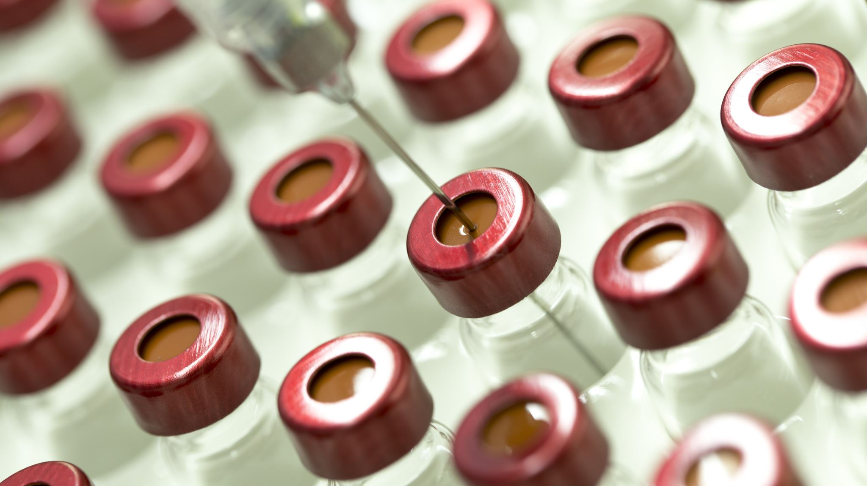
Assessment for
Fluid-responsiveness

Slide 10

Frank-Starling relationship
This is relationship between cardiac preload and stroke volume.
Increasing preload increases the stroke volume
Increase in SV is higher for the initial (steep) part of curve
Increase in SV is very less at the flat part
Stroke Volume
A
B
C
Preload

Slide 11

Frank-Starling relationship
Raised Contractility: inotropes, digoxin, exercise
Normal Contractility
Stroke Volume
Reduced contractility: heart failure
For a given preload, if contractility increases, stroke volume increases
Preload
Three physiologic options to increase stroke volume: ↑preload, ↑ contractility, ↓afterload

Slide 12
Traditional/static measures of preload/fluid status
Central venous pressure
Pulmonary artery occlusion pressure

Slide 13
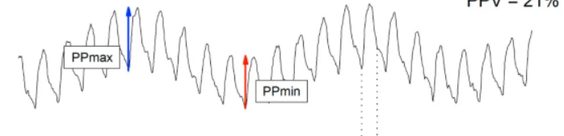
Dynamic measures of Preload/fluid status
There is a cyclical change in cardiac output changes during inspiration and expiration due to change in cardiac preload.
This change in preload is exaggerated if intravascular volume is low.
Dynamic measures of fluid status utilize this concept to detect patients who are hypovolemic.
Better than static/traditional measures.
Changes in cardiac output can also be measured as variation in SBP and pulse pressure

Slide 14
Dynamic indices of preload
Method | Threshold | Remarks
SVV | 12% | Not used in following condition Spontaneously breathing patients Mechanical ventilation with tidal volumes < 8 mL/kg Arrhythmias Raised intra-abdominal pressure
PPV | 12%
IVC variation | 12%
Passive leg raising | 10% ( CO) | Require continuous cardiac output monitoring
Fluid challenge (300-500 ml) | 15% (CO) | Risk of fluid overload if non-responsive
Mini-fluid challenge (100 ml) | 6% (CO)

Slide 15
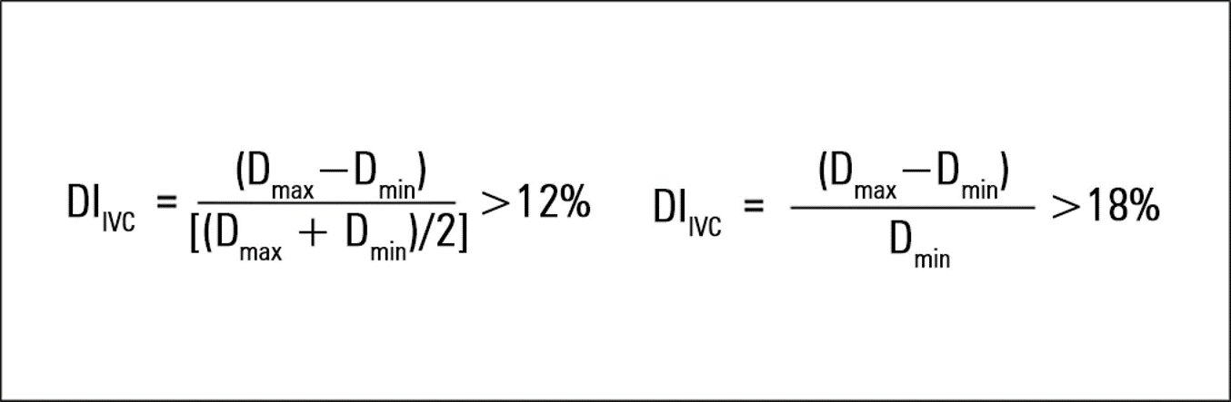
IVC Parameters
IVC Distensibility index:-
Used in mechanical ventilated patients
During mechanical ventilation IVC distends during inspiration and collapse during expiration.

Slide 16
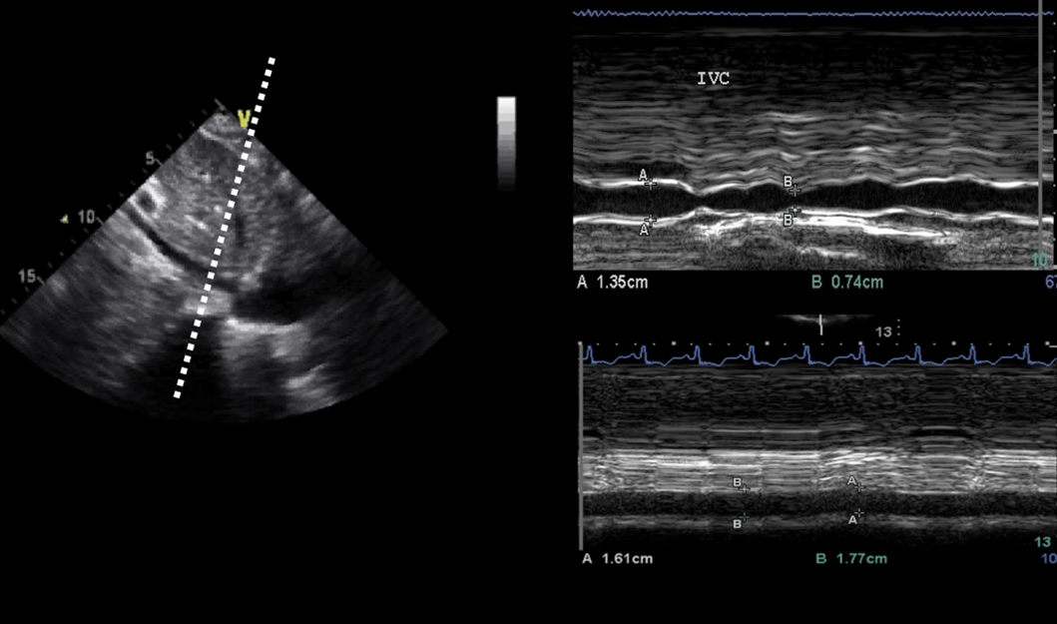

Slide 17
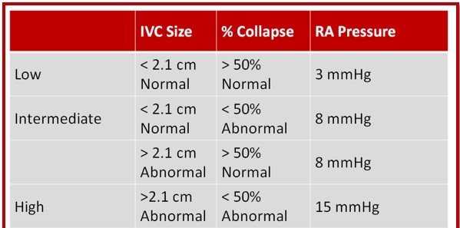

Slide 18
Passive Leg Raising
Endogenous fluid challenge.
Self volume challenge
Completely reversible
Appropriate in spontaneously breathing patients.
Can be used in the presence of arrhythmias.
Not depends on heat- lungs interaction.
Requires a real-time CO assessment device.

Slide 19
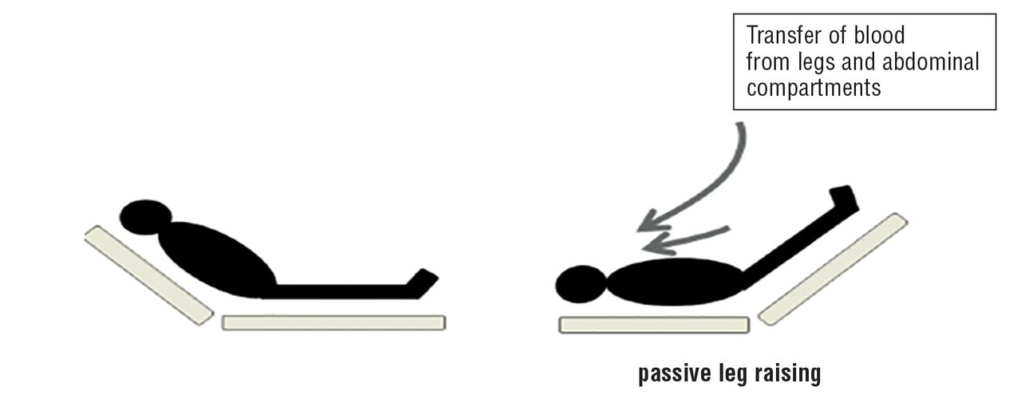
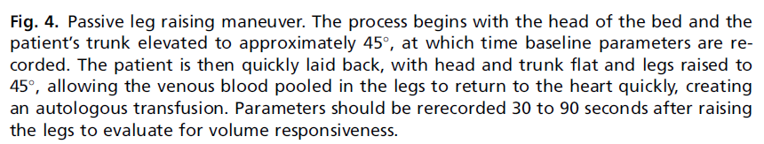
Passive leg raising

Slide 20

Fluid Management

Slide 21
Sepsis
2021 sepsis guidelines, suggest that fluid should be aggressively administered at 30ml/kg in 3 hour in a setting of hypotension or lactate concentration greater than 4 mmol/l.

Slide 22
Acute Hemorrhage
 | Class I | Class II | Class III | Class IV
Blood loss (ml) | Up to 750 | 750 to 1,500 | 1,500 to 2,000 | >2,000
Blood loss (%) | Up to 15% | 15% to 30% | 30% to 40% | >40%
Pulse rate (bpm) | <100 | 100 to 120 | 120 to 140 | >140
Systolic BP | Normal | Normal | Decreased | Decreased
Pulse pressure | Normal/ increased | Decreased | Decreased | Decreased
Respiratory rate | 14 to 20 | 20 to 30 | 30 to 40 | >35
Urine output (ml/h) | >30 | 20 to 30 | 5 to 15 | Negligible
CNS/mental status | Slightly anxious | Mildly anxious | Anxious, confused | Confused, lethargic
Initial fluid replacement | Crystalloid | Crystalloid | Crystalloid and blood | Crystalloid and blood

Slide 23
Maintenance Fluid
For maintenance fluid: A combination of DNS, RL, NS etc. is used based on clinical condition, blood glucose and electrolyte status
Amount: by 4-2-1 formula (Holliday-segar formula)
Hourly fluid intake: an example for 85 kg patient
  Initial 10 kg X 4 = 40 ml
  Next 10 kg X 2= 20 ml
  Remaining 45 kg X 1= 45 ml
  So total 40 + 20+ 45 = 105 ml/hour
1mmol/kg/d: potassium, sodium and chloride
50-100 g/day glucose
The calculated fluid is modified as per the existing fluid status of the patient.
Patients with relative hypovolemia are given more fluid; patients fluid overload are given less fluid

Slide 24
Monitoring the responses:-
Heart rate, blood pressure, urine output, skin turgor, mucus membrane, and mental status
Serum electrolyte, lactate, and urinary sodium should also be intermittently followed (within 6 to 24 hours).
Dynamic indices of fluid status for fluid responsiveness

Slide 25
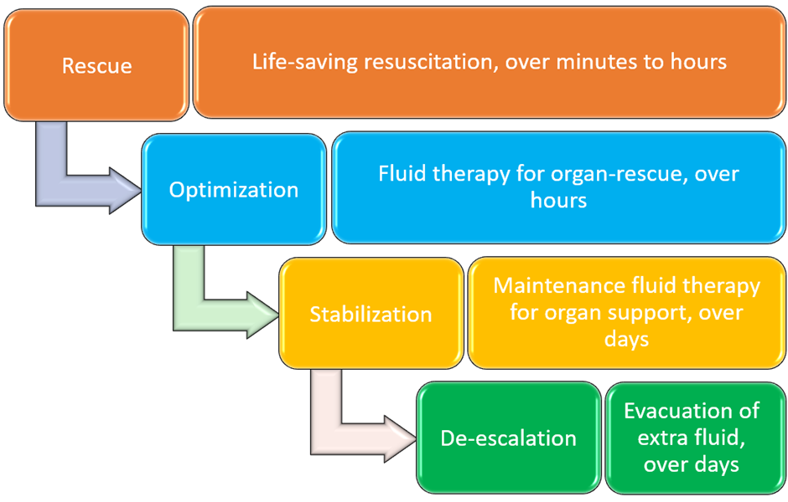
De-escalation after resuscitation
Excess fluid load leads to delayed extubation and prolonged ICU stay.

Slide 26

THANK YOU

